Slide 1


Digital Transformation
- P&G
1

Slide 2

Agenda
1
Current Digital Status
2
Transformation Strategy
3
Technology Architecture Needed
4
Predicted Business Outcomes
5
Roadmap
2

Slide 3
Overview of P&G
Foundation and History:
Established: 1837 by William Procter and James Gamble.
Origin: Started as a small soap and candle company in Cincinnati, Ohio.
Growth: Evolved over nearly two centuries into a global leader in consumer goods.
Business Scope:
Categories: Operates in multiple segments including Beauty, Grooming, Health Care, Fabric & Home Care, and Baby, Feminine & Family Care.
Global Reach: Serves millions of consumers worldwide.
Market Leadership: Known for its innovation and brand-building expertise.
Financial Highlights:
Revenue and Growth: Consistent revenue growth, positioning it as a Fortune 500 company.
Market Impact: A key player in the global market with a strong financial performance.
3

Slide 4
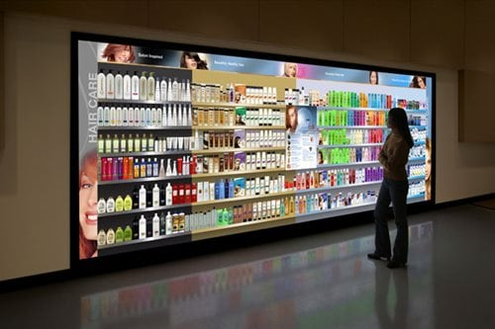
P&G Current Digital Status --> Real-Time Insights
Virtual Store Shelves
Simulate store shelves for consumer testing.
--> experiment various arrangements of
products to see which is more appealing
--> augment the ability to make real-time
adjustments
4
Notes:
P&G can modify the product arrangement or packaging in the virtual environment without the need for physical rearrangement or manufacturing new prototypes.

Slide 5
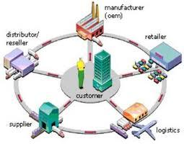
P&G Current Digital Status --> From Factory to Shelf
Control Tower Program
Monitor all transportation and logistic: inbound,
outbound, raw materials, finished product.
--> reduce “deadhead” movement by 15%
--> directly link with distributors, facilitating
business operations
5
Notes:
digitally connected to retailers too. For example, use GDSN, which is basically a standardized data warehouse that allows us to connect with retail partners in totally automated way.
link:
https://www.mckinsey.com/industries/consumer-packaged-goods/our-insights/inside-p-and-ampgs-digital-revolution
*deadhead movement:
where trucks are empty or not optimally loaded

Slide 6
Assessment on Current Digital Status
What P&G did well
What more can they do
1
Use digital technology to improve operational
efficiency and supply chain management
Add Blochchain to enhace transaction
2
Collect real-time data to enhance consumer engagement and market research

Slide 7
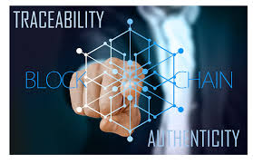
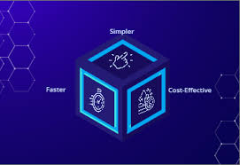
Blockchain Implementation
Enhanced Traceability
Improves traceability of products
Increases visibility into the journey of products
Reduces the risk of counterfeit goods
Cost Savings
Reduces costs associated with manual processes
Lowers transaction costs
Minimizes dispute resolution expenses
Data-driven Insights
Improves data analytics capabilities and Informed decision-making
Better understanding of consumer demand patterns
Opportunities for data-driven innovations and optimizations
6

Slide 8

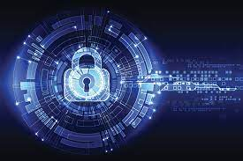
Blockchain Implementation
Auditable History
History of a product is recorded and is auditable
Supports regulations compliance
Simplifies auditing processes and provides a comprehensive record
Enhanced Security
Increases security through decentralized and cryptographic principles
Mitigates risks of data breaches and unauthorized access
Streamlined Payments
Implementation of smart contracts for automated and transparent payment processes.
Improves financial management
7

Slide 9
Business Processes for Transformation
Supply Chain and
Inventory Operations
Financial and
Payment Systems
Data Management
and Analytics
Compliance and Other
Accounting and Cost Management
Managing transaction costs, dispute resolutions, and overall cost-effectiveness.
Financial Operations
Streamlining financial management and cash flow processes.
Payroll
Automating payment processes with smart contracts.
Compliance
Ensuring products and processes comply with necessary regulations.
Audit Readiness
Maintaining the financial records to be auditable.
Information Security
Protecting data integrity, confidentiality, and mitigating risks of breaches.
Inventory Management
Tracking and tracing products through their lifecycle.
Supply Chain Management
Managing the flow of goods and services, including raw materials and final products.
Procurement
Selecting and managing suppliers and intermediaries.
Data analytics
Analyzing comprehensive datasets for better insights.
Market Research
Tailoring products and services to meet market needs.
Consumer Analysis
Understanding consumer spending patterns, and demand.
8

Slide 10
Technology Requirements
In areas of architecture, assets, and artifacts
For Digital Prototyping and Virtual Store Shelves
For Control Tower Program
For Blockchain Implementations
Integration
Cloud Computing Infrastructure
To support heavy computational tasks involved in digital prototyping and simulating virtual store shelves.
Advanced Modelling Software
For creating accurate and detailed product models and virtual environments.
High-Performance Computing (HPC) Solutions
To enable rapid iterations and simulations.
Immersive Technology
Including AR/VR systems to create realistic virtual store shelves.
Integrated Logistics Platform
A centralized system to monitor all transportation and logistics activities.
IoT Devices and Sensors
To track real-time movement of inbound and outbound logistics.
Advanced Analytics and AI
For predictive analytics and optimization of logistics operations.
Blockchain Technology
For secure and transparent record-keeping of logistics data.
Blockchain Infrastructure
For creating a secure, decentralized ledger for product traceability and auditable history.
Smart Contract Development Environment
To automate transactions and streamline payment processes.
Data Security Solutions Including encryption and cybersecurity measures to protect sensitive data.
Data Integration Tools
To assimilate blockchain data with existing systems for enhanced analytics and insights.
APIs and Integration Layers
For seamless integration of various systems and technologies.
User Interfaces (UI)
For internal and external users to interact with these systems.
8

Slide 11
Strategies for Implementation
Phased Roll-Out Strategy
To gradually implement new technologies and systems, allowing for adjustments based on feedback.
Change Management Plan
To address the organizational impact and ensure the smooth adoption of new technologies.
Continuous Improvement Framework
For ongoing evaluation and enhancement of the technology architecture.
Partnerships with Tech Providers
To leverage external expertise and stay updated with evolving technologies.
9

Slide 12
Roadmap
Research and
Assesment
3. Build Cross-Functional Teams
4. Develop a Proof of
Concept (PoC)
5. Regulatory Compliance
2. Define Objectives
6. Pilot Implementation
7. Scale Up and Integration
8. Continuous Improvement
9. Ecosystem Development
10. Long Term Strategy
10

Slide 13
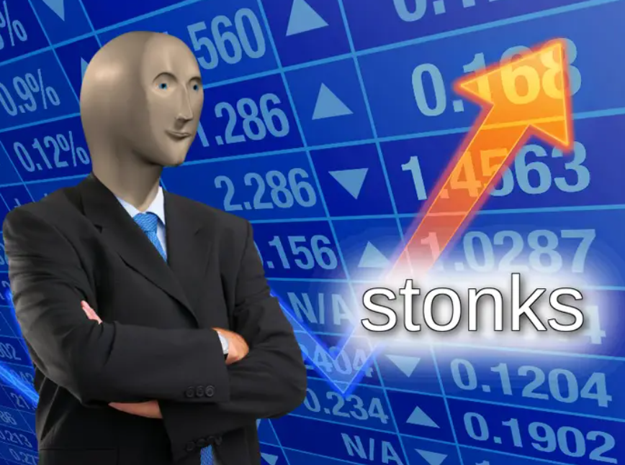
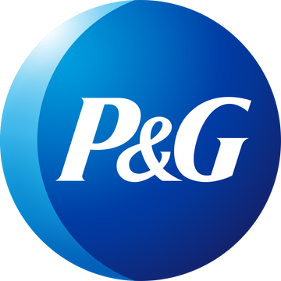
That's
a wrap!
Any
Questions?
11

